Slide 1


Phish & Furious Unraveling Campaign Builder Vulnerabilities in a Blink-and-Breach World
Presented by: Raae Wolfram
BSides Conference 2024
Raae Wolfram / $digitalraae

Slide 2




>whoami
Technology Professional, >15 years, non-traditional path
Sr. Product Manager @ Microsoft
New Yorker / Latina
Mom
Star Trek Fan
Had brain surgery in 2016; radiation in 2022
I don’t drive ¯\_(ツ)_/¯

Slide 3

>Phish & Furious Overview
Fast Track Defense: Getting up to Speed
>> Common flaws in tools like Mailchimp can be misused
>> Legitimate platforms like Mailchimp can undermine organizational reputation and security
>> Industry initiatives can drive adoption of mitigation strategies
Notes:
This presentation will cover vulnerabilities in campaign builders such as Mailchimp and how they can be exploited for phishing attacks.
We will cover technical aspects like trust manipulation and the scalability of these attacks, along with key considerations for mitigating these risks.
The overall aim is to provide practical strategies to understand and combat evolving phishing threats.

Slide 4


>A “Family” of Protocols
01
SPF
03
02
DMARC
DKIM
Notes:
SPF, DKIM and DMARC are 3 separate email security protocols.
Implementing SPF, DKIM, and DMARC together fortifies our email systems against spoofing and phishing.
It ensures that every email not only comes from an authorized server but also remains unchanged during transit and meets our security policies.
This trio of protocols provides a robust framework for maintaining the integrity and security of our digital communications.
While each can stand alone, their real power is unleashed when integrated and used together.

Slide 5
>Force Multipliers: SPF
01
SPF identifies authorized mail servers – prevents spoofed messages by ensuring that emails come from authorized sources.
01
SPF
02
DKIM verifies email integrity and sender identity – ensures that emails haven’t been tampered with and come from authorized servers.
03
02
DMARC
DKIM
03
DMARC provides instructions on handling emails that fail SPF or DKIM checks – combines SPF and DKIM to enhance email security; prevents domain spoofing and phishing attacks..
SPF == Sender Policy Framework // DKIM == DomainKeys Identified Mail // DMARC == Domain-based Message Authentication, Reporting, and Conformance
Notes:
SPF (Sender Policy Framework):
Purpose: SPF helps identify authorized mail servers for a domain.
Analogy: Think of SPF like an employee directory that confirms whether an employee works for an organization. Similarly, SPF records list all the IP addresses of servers allowed to send emails from a domain.
Function: When a mail server receives an email, it checks against the SPF record to verify if the sender’s server is legitimate.
Outcome: SPF prevents spoofed messages by ensuring that emails come from authorized sources.
Strengths:
Ease of Implementation: SPF is generally simpler to implement than DMARC and DKIM. It involves adding a TXT record to the DNS settings of a domain to specify the list of authorized mail servers.
Straightforward Authentication: SPF directly verifies the sender’s IP address against the list of authorized mail servers.
Reduces Spoofing: It helps prevent unauthorized parties from impersonating legitimate senders.
Weaknesses:
Dependence on IP Addresses: SPF relies solely on IP address verification, which can be problematic when emails are sent through third-party services (e.g., Mailchimp). If the sender’s IP address changes, the SPF record must be updated.
No Message Integrity Verification: While SPF verifies the sender’s IP address, it does not assure the integrity or authenticity of the email content itself¹.

Slide 6

>Lightwork Groundwork: SPF Fundamentals
"v=spf1 ip4:72.237.4.96 ip4:72.237.4.121 include:_spf.google.com include:_spf.salesforce.com include:spf1.[REDACTED].edu include:spf2.[REDACTED].edu include:spf3.[REDACTED].edu include:spf4.[REDACTED].edu ~all"
~all
VS
-all
Notes:
How It Works: When an email is sent, the receiving server looks up the SPF record of the sender's domain. The SPF record lists all the authorized sending IPs or mechanisms. The receiving server then checks if the email came from one of these authorized sources.
Checking -all vs ~all: If the sending source is not listed, the action the receiving server takes depends on whether the SPF record ends in -all or ~all. A -all will typically lead to rejection of the email, while a ~all will mark the email but potentially still deliver it.

Slide 7
>Force Multipliers: DKIM
01
SPF identifies authorized mail servers – prevents spoofed messages by ensuring that emails come from authorized sources.
01
SPF
02
DKIM verifies email integrity and sender identity – ensures that emails haven’t been tampered with and come from authorized servers.
03
02
DMARC
DKIM
03
DMARC provides instructions on handling emails that fail SPF or DKIM checks – combines SPF and DKIM to enhance email security; prevents domain spoofing and phishing attacks..
SPF == Sender Policy Framework // DKIM == DomainKeys Identified Mail // DMARC == Domain-based Message Authentication, Reporting, and Conformance
Notes:
DKIM, or DomainKeys Identified Mail, verifies the integrity of email content and confirms the sender's identity through digital signatures.
How DKIM Works:
Signing Process: "Domain owners use a private key to sign outgoing emails and attach the digital signature to the email header.
Verification Process: "Receiving servers use the public key, available in the domain's DNS records, to check this signature. This confirms that the email is genuinely from the claimed domain and hasn't been altered.“
Key Benefits of DKIM:
Content Integrity: "Ensures the email content remains unchanged during transit, protecting against tampering.“
Sender Authentication: "Provides proof that the email comes from the stated sender, enhancing trust.“
Challenges with DKIM:
Setup Complexity: "Implementing DKIM involves configuring cryptographic keys and DNS settings, which can be technically demanding.“
Spoofing Limitations: "Although DKIM verifies content integrity, it doesn't block emails from unauthorized servers; it simply identifies them.“
Conclusion: "DKIM is crucial for safeguarding email content and authenticity. Proper implementation fortifies our defenses against content tampering and identity spoofing.

Slide 8
>Force Multipliers: DMARC
01
SPF identifies authorized mail servers – prevents spoofed messages by ensuring that emails come from authorized sources.
01
SPF
02
DKIM verifies email integrity and sender identity – ensures that emails haven’t been tampered with and come from authorized servers.
03
02
DMARC
DKIM
03
DMARC provides instructions on handling emails that fail SPF or DKIM checks – combines SPF and DKIM to enhance email security; prevents domain spoofing and phishing attacks..
SPF == Sender Policy Framework // DKIM == DomainKeys Identified Mail // DMARC == Domain-based Message Authentication, Reporting, and Conformance
Notes:
Introduction to DMARC: "DMARC, which stands for Domain-based Message Authentication, Reporting, and Conformance, is a protocol designed to build on the foundations of SPF and DKIM to further enhance our email security efforts.“
Function of DMARC: "DMARC functions by providing guidelines to email receivers on how to handle messages that fail SPF or DKIM checks. It allows us to define clear actions—whether to quarantine, reject, or deliver these emails. This ensures that only authenticated and verified emails reach users.“
Key Outcome: "The primary outcome of DMARC is to prevent domain spoofing and phishing attacks.“
Strengths of DMARC:
Comprehensive Protection: "DMARC synchronizes the efforts of SPF and DKIM, ensuring they work more effectively together to block fraudulent emails.“
Reporting and Visibility: "It offers insights through detailed reports on email authentication failures, allowing us to understand and respond to threats more proactively.“
Gradual Implementation: "Organizations can implement DMARC in a monitoring mode initially, which allows for observation and tuning of the settings before moving to enforce stricter policies.“
Weaknesses:
Dependency: "DMARC requires both SPF and DKIM to be in place. It cannot function independently, so proper setup of these protocols is critical."
Setup Complexity: "The initial setup and configuration of DMARC policies demand careful planning to ensure they align with our security objectives and operational needs.“
DMARC’s Role with SPF Tags
DMARC builds on the foundations of SPF (and DKIM) by specifying what actions should be taken when emails fail SPF and/or DKIM checks. Here's how -all and ~all interact with DMARC:
Enhanced Enforcement with -all: When DMARC checks an SPF record with a -all policy, a failure will likely lead to DMARC taking stronger actions based on its own policy. If the DMARC policy is set to reject (p=reject), emails failing the SPF check with -all will be rejected, aligning the SPF and DMARC policies closely.
Handling SoftFail (~all): In cases where SPF is set to ~all, DMARC provides a mechanism to handle these failures more flexibly. For instance, if the DMARC policy is set to quarantine (p=quarantine), emails that fail the SPF check with ~all might still be quarantined instead of outright rejected, allowing some room for handling potential false positives.

Slide 9
>Force Multipliers
01
SPF identifies authorized mail servers – prevents spoofed messages by ensuring that emails come from authorized sources.
01
SPF
02
DKIM verifies email integrity and sender identity – ensures that emails haven’t been tampered with and come from authorized servers.
03
02
DMARC
DKIM
03
DMARC provides instructions on handling emails that fail SPF or DKIM checks – combines SPF and DKIM to enhance email security; prevents domain spoofing and phishing attacks..
SPF == Sender Policy Framework // DKIM == DomainKeys Identified Mail // DMARC == Domain-based Message Authentication, Reporting, and Conformance
Notes:
Integrating SPF, DKIM, and DMARC does more than just enhance individual email security—they create a robust network of checks that together offer a comprehensive defense against the most common threats like spoofing and phishing. These protocols ensure that our email environments are not only secure but also resilient against evolving cybersecurity threats.

Slide 10



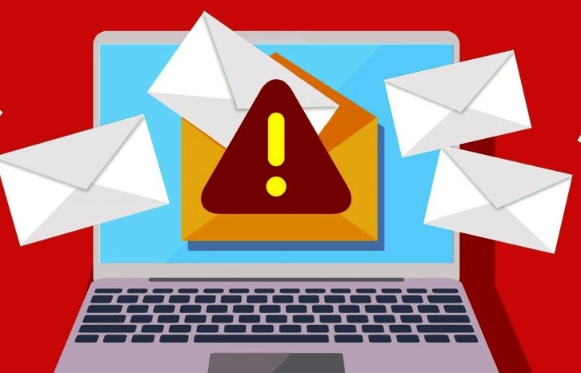

>Domain Drift & Cyber Mayhem:
A Saga in 4 Parts – Pt 1.
Get Domain Creds
Setup Campaign Builder
Send Campaign Blast
Wreak Havoc at Scale
>> Options: phishing emails, social engineering tactics, or exploiting vulnerabilities in the organization's network.
>> Insider threat could leak sensitive information or maliciously mishandle individual access
>> Choose a campaign platform – in this case, we used Mailchimp for Research purposes
>> Use domain account to verify email address with the service
>> Replace original domain email with spoof sender, (e.g., helpdesk@, support@, etc.)
>> Can send to internal user list or external targets
>> While this requires a compromised domain email to start, the cascading fallout is non-trivial and could be catastrophic based on target and scenario

Slide 11
>Domain Drift & Cyber Mayhem:
A Saga in 4 Parts – Pt 2.
Get Domain Creds
Setup Campaign Builder
Send Campaign Blast
Wreak Havoc at Scale
>> Options: phishing emails, social engineering tactics, or exploiting vulnerabilities in the organization's network.
>> Insider threat could leak sensitive information or maliciously mishandle individual access
>> Choose a campaign platform – in this case, we used Mailchimp for Research purposes
>> Use domain account to verify email address with the service
>> Replace original domain email with spoof sender, (e.g., helpdesk@, support@, etc.)
>> Can send to internal user list or external targets
>> While this requires a compromised domain email to start, the cascading fallout is non-trivial and could be catastrophic based on target and scenario

Slide 12
>Domain Drift & Cyber Mayhem:
A Saga in 4 Parts – Pt 3.
Get Domain Creds
Setup Campaign Builder
Send Campaign Blast
Wreak Havoc at Scale
>> Options: phishing emails, social engineering tactics, or exploiting vulnerabilities in the organization's network.
>> Insider threat could leak sensitive information or maliciously mishandle individual access
>> Choose a campaign platform – in this case, we used Mailchimp for Research purposes
>> Use domain account to verify email address with the service
>> Replace original domain email with spoof sender, (e.g., helpdesk@, support@, etc.)
>> Can send to internal user list or external targets
>> While this requires a compromised domain email to start, the cascading fallout is non-trivial and could be catastrophic based on target and scenario

Slide 13
>Domain Drift & Cyber Mayhem:
A Saga in 4 Parts – Pt 4.
Get Domain Creds
Setup Campaign Builder
Send Campaign Blast
Wreak Havoc at Scale
>> Options: phishing emails, social engineering tactics, or exploiting vulnerabilities in the organization's network.
>> Insider threat could leak sensitive information or maliciously mishandle individual access
>> Choose a campaign platform – in this case, we used Mailchimp for Research purposes
>> Use domain account to verify email address with the service
>> Replace original domain email with spoof sender, (e.g., helpdesk@, support@, etc.)
>> Can send to internal user list or external targets
>> While this requires a compromised domain email to start, the cascading fallout is non-trivial and could be catastrophic based on target and scenario

Slide 14

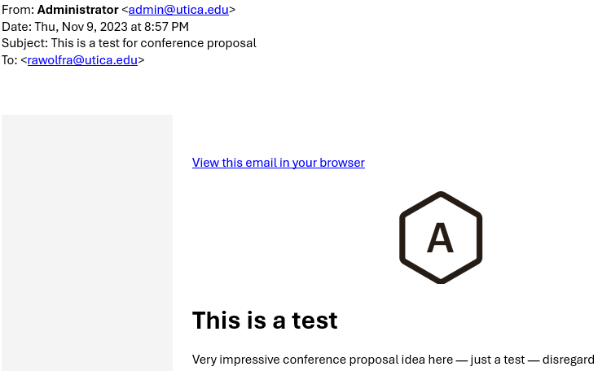
>Let’s Drive this Forward…
Historical HTML Campaigns
>> As of late 2023, marketing platform supported campaign delivery to internal org recipients && external accounts, with only the original account holder address verified with service
>> So, if <pawn>[@]university.edu signed up for service and verified account, then <pawn> can send emails appearing as ANY account (actual or fictitious) with the verified domain.

Slide 15
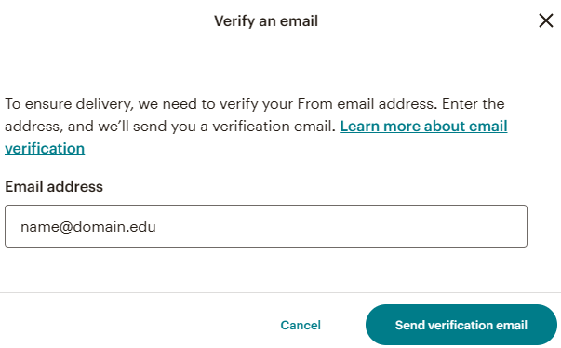
>On Your DMARCs, Ready, Set…
HTML Campaigns 2.0 for 2024
>> Google and Yahoo launched new DMARC requirements that went into effect February 2024 for any org that sends >5K emails – Marketing platform updated their UI to require email verification from individual senders
>> ”…SPF and DKIM provide protection against impersonation through better authentication, while DMARC creates a notification channel back to the domain-name owner to collect information on whether their email is being spoofed.”
Read more: https://www.darkreading.com/cybersecurity-operations/google-yahoo-push-dmarc-forcing-companies-to-catch-up

Slide 16
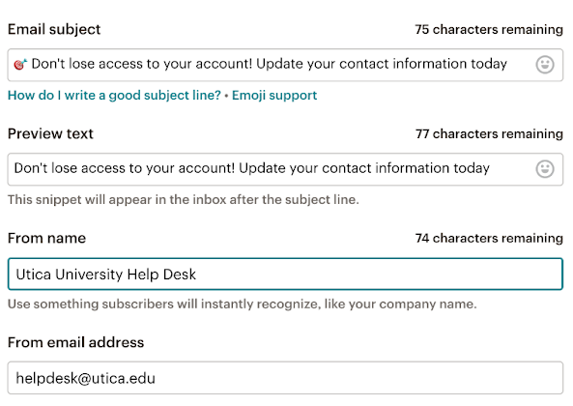
>Let me take you for a ride…
Spoofpocalypse Begins…
>> We registered for service with pawn[@]<university>.edu address, but we’re able to replace the original sender with the desired spoof sender: helpdesk[@]<university>.edu
>> We can customize From name to further drive appearance of legitimacy

Slide 17
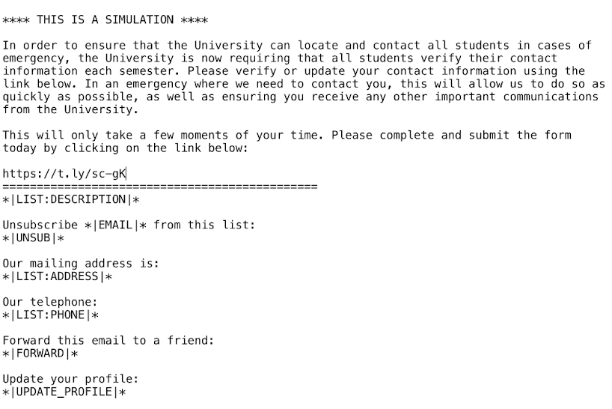
>Going High Octane
Plaintext still packs a punch
>> Plaintext == no styling, just text – no images. Nothing fancy.
>> Lots of orgs use plaintext for legitimate comms – crisis management, service-related info, major time sensitive updates, calls to action, etc.
>> The email body included a URL that routed to a Rick Rolling video…

Slide 18
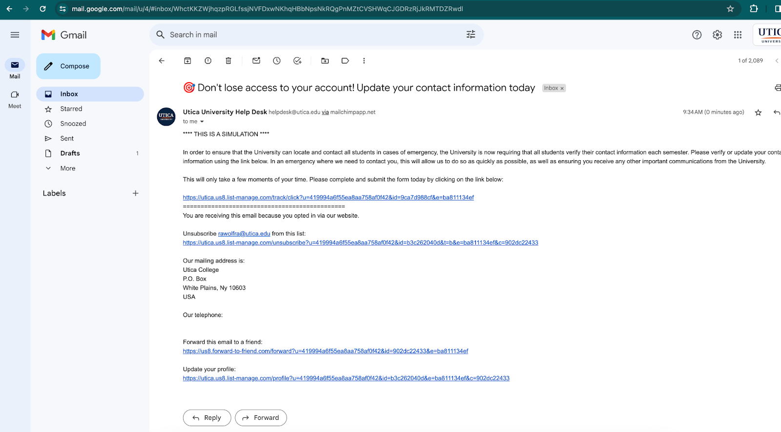
>[Desk]Top Gear POV
Red Flags as Technical Controls
>> Campaign sent to internal org addresses && external recipients – on desktop view, “via mailchimp” is appended to sender
>> Mail still arrived in Inbox without an alert, External banner, etc
>> Do targets got enough sense to not get got?

Slide 19
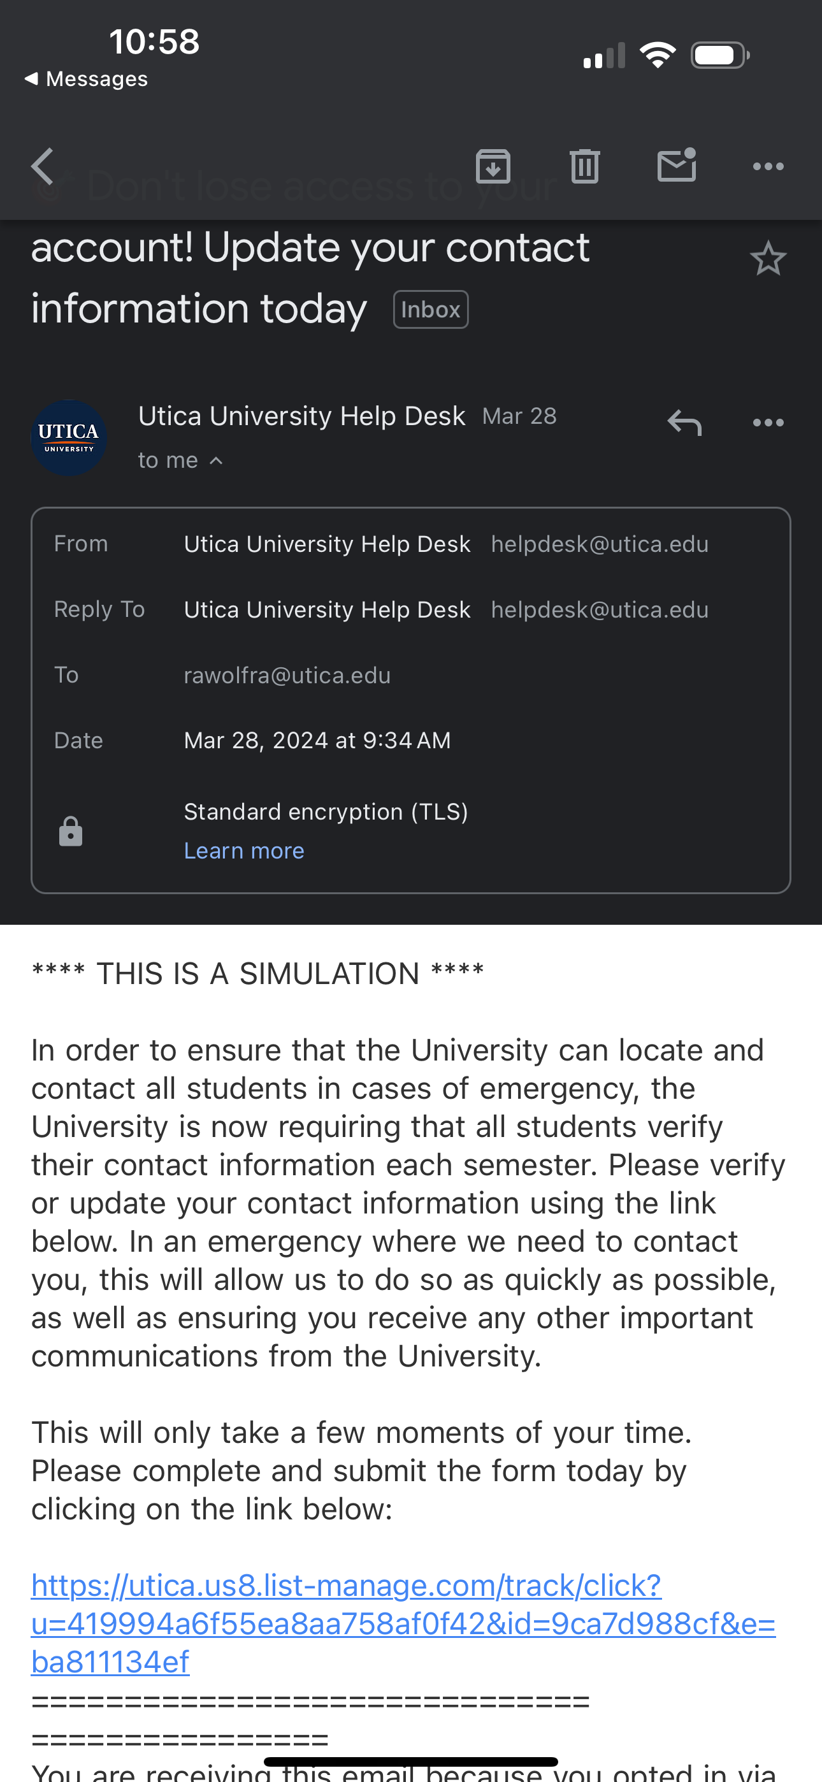
>Winning is winning…
All good rides come to an end(point)!
>> Mobile view comes in flawless, no “via service” appended to sender address
>> Campaign builder converted original URL to a string that includes the domain and appears legitimate

Slide 20


>Engine Check
Submitted a report via Responsible Disclosure program – returned as Out of Scope and Closed
Mar 29, 2024, 1:42 PM EDT
Authentication is our way to ensure safety of your domain and the email that is being sent to arrive in the inbox.
Without authentication, there is not much on our end we can do to ensure these things…this would actually be on your domains end rather than our end here. Either way, authentication will solve this...
Reached out to campaign builder service and shared concerns – received response that the burden is on the org to setup controls
Notified org of the situation and they are working to address
- Name Redacted, Mailchimp
Asking the question: if marketing service can enhance controls for HTML Campaigns – which falls in their control – why is the talk track that orgs can go CTRL F themselves for Plaintext Campaigns?

Slide 21





>Rollout && Follow-up
Vendor Controls
>> Update UI to restrict plaintext email campaigns to send with only verified accounts (at minimum)
Security Program Mitigations
Good Cyber Citizenship
>> SPF, DKIM, and DMARC
>> Set up an external banner or flag for emails delivered by Mailchimp servers
>> Use Advanced Email Filtering Solutions
>> End User Training and Awareness Efforts
>> Google & Yahoo's 2024 DMARC sets new standards in email security to thwart spoofing and phishing.
>> Their lead in the email sector paves the way for broader digital safety, urging all tech sectors to strengthen defenses.
>> A unified effort is key in our interconnected digital world.
Org Controls
>> Strengthen Email Authentication: SPF, DKIM, DMARC help verify the authenticity of incoming emails and prevent spoofing
Notes:
“The implementation of DMARC by these industry leaders not only fortifies their own email ecosystems but also sets a precedent for the broader digital community. It highlights the necessity for collective action in cybersecurity, urging various sectors beyond email services to integrate similar security measures. This approach is vital for protecting the interconnected fabric of the global digital landscape, emphasizing the need for unified cybersecurity efforts across all online platforms and services.”

Slide 22
Thank you

